Slide 1
Customer Segmentation with Actionable Insights
Submitted by: Suraj Singh G40 AI&ml

Slide 2
Business Problem
• E-commerce company wants better marketing & retention.
• Goal: Group customers and recommend business actions.
• Dataset: 2000 customers, 11 features (RFM + Demographics).

Slide 3
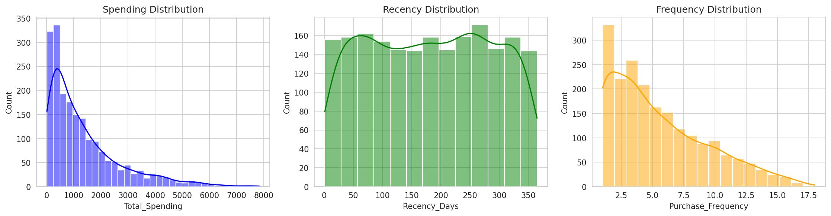
Exploratory Data Analysis
Spending, Recency, Frequency Distributions

Slide 4
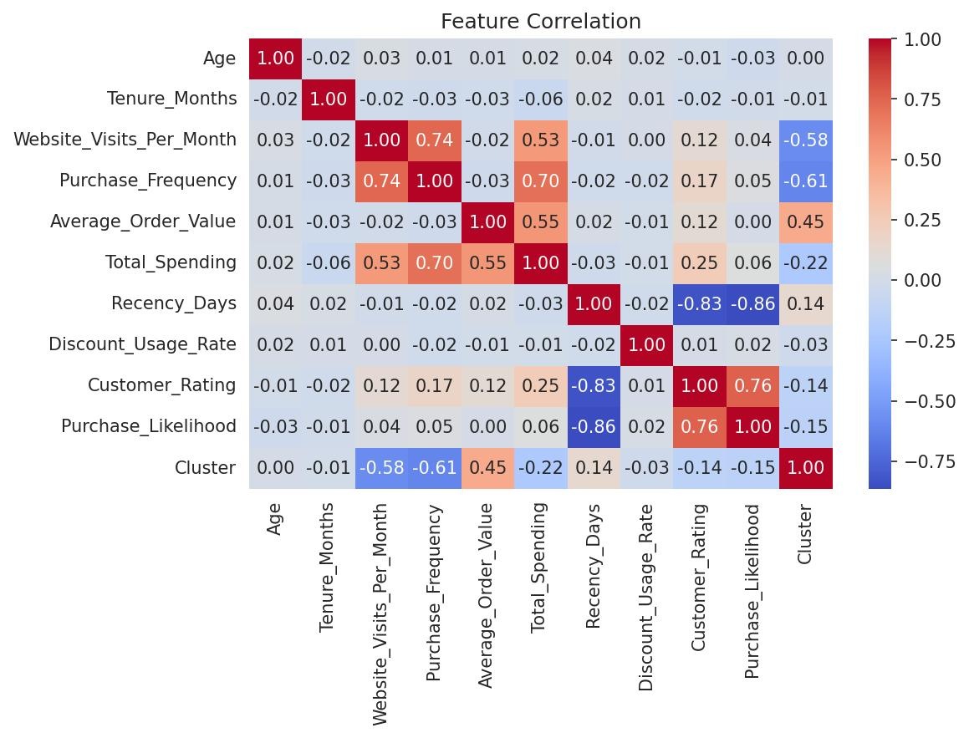
Feature Correlations
Spending highly correlated with Frequency (0.70)

Slide 5
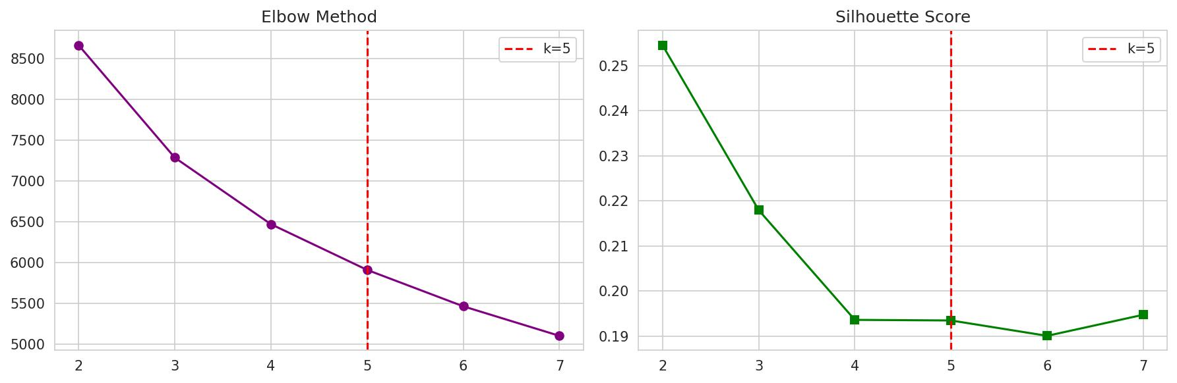
Selecting Optimal Clusters (k=5)
Elbow + Silhouette validated k=5

Slide 6
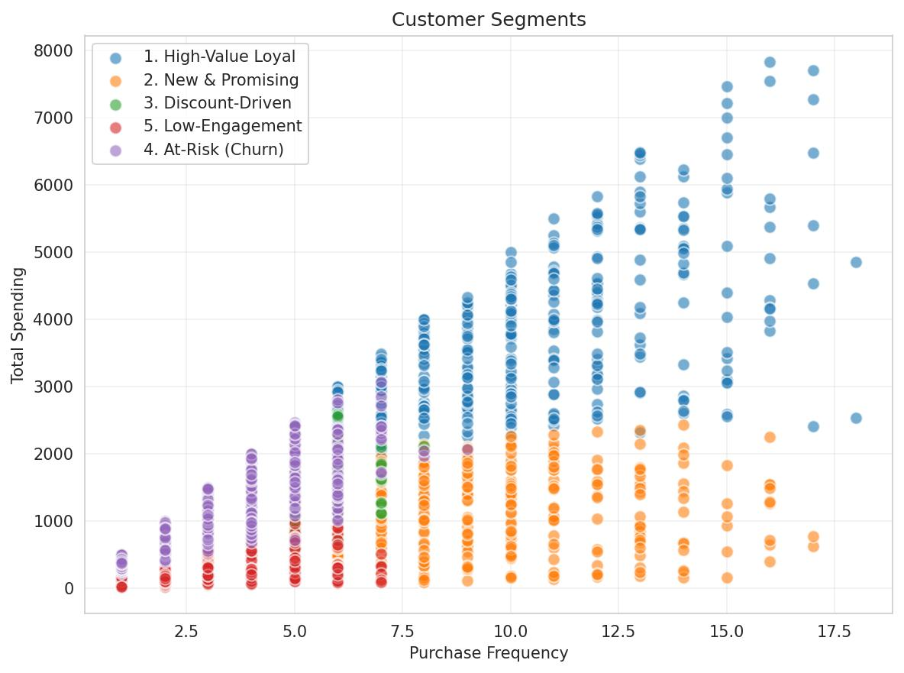
Customer Segments Visualization
5 distinct behavioral groups identified

Slide 7
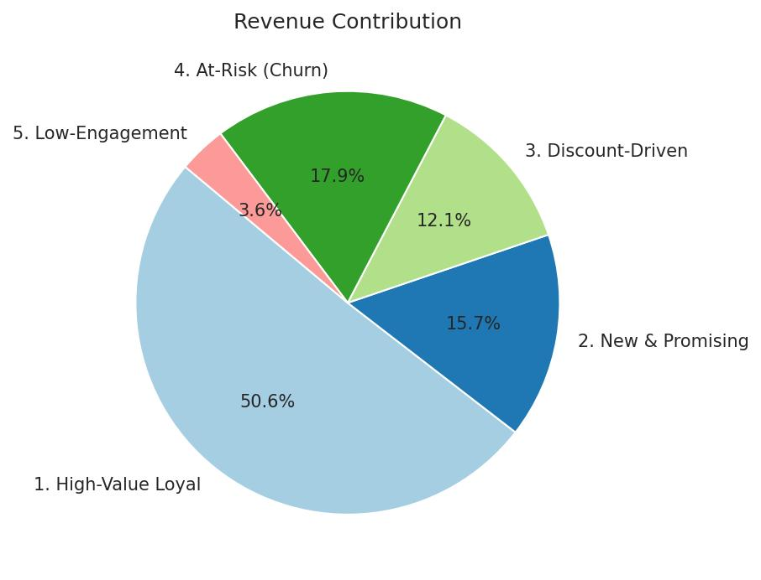
Revenue Contribution by Segment
High-Value Loyal contributes 50.6% of total revenue

Slide 8
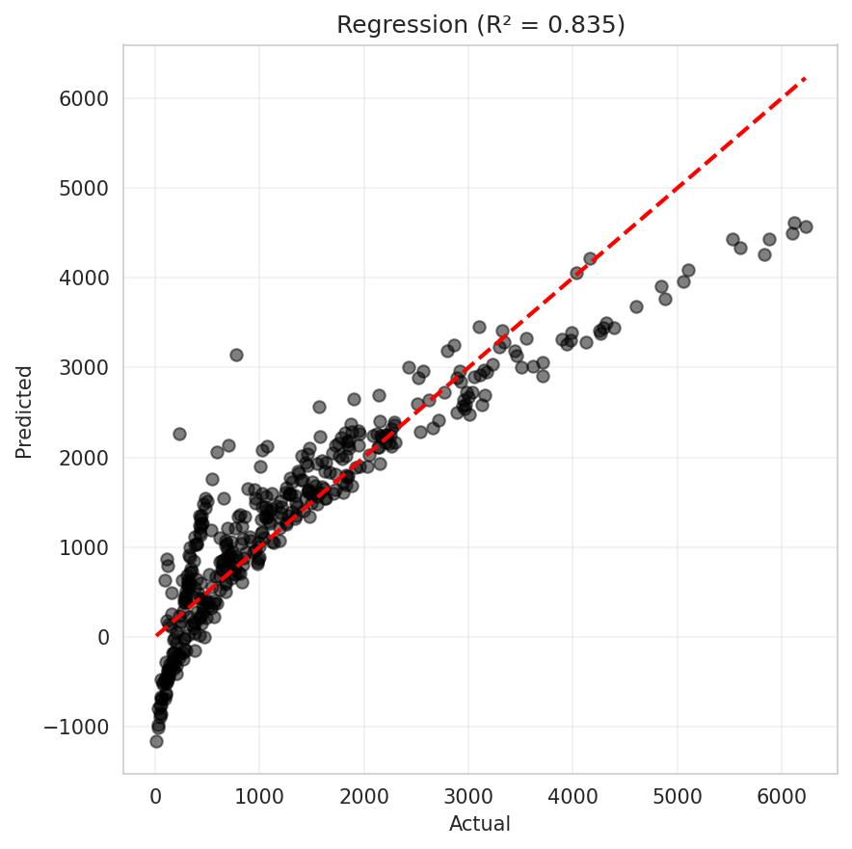
Regression: Predict Total Spending (R² = 0.833)
Top Driver: Purchase Frequency

Slide 9
Actionable Business Strategies
Loyal: VIP program, early access. AVOID heavy discounts.
New: Onboarding emails, 10% off 2nd purchase.
Discount: Flash sales, bundle offers (Limited time).
At-Risk: URGENT! 'We miss you' emails + 20% coupon.
Low-Engagement: Low-cost newsletters (Lowest budget).

